Slide 1
Better Decisions Making For Connected and Autonomous Vehicles
Bobby Cottam P.E.
Notes:
Cover option #3:
Please tailor photos to your audience and remember to fill in the month at the bottom left.

Slide 2

Terminology of transportation technology
2
Connected Vehicles (CVs)
Autonomous Vehicles (AVs)
Connected Autonomous Vehicle (CAVs)
Electric Vehicles (EVs)
Mobility as a Service (MaaS)
Internet of Things (IoT)

Slide 3
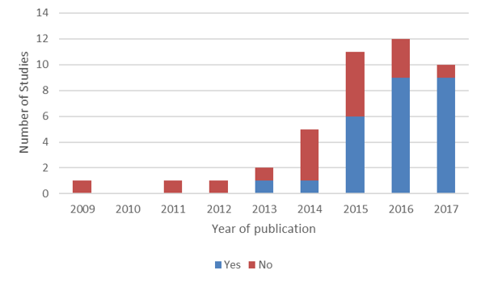
Metropolitan planning organization (over 1 million people) that discuss CAVs in their LRTP
3
Cottam, B. Transportation Planning for Connected Autonomous Vehicles: How it All Fits Together, TRR 2019

Slide 4
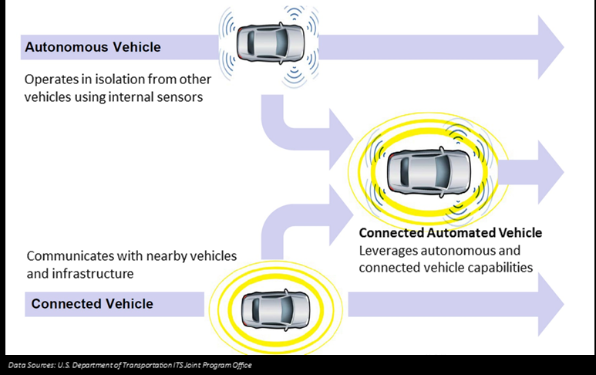
4
AV vs CV
https://www.nevadadot.com/mobility/avcv

Slide 5
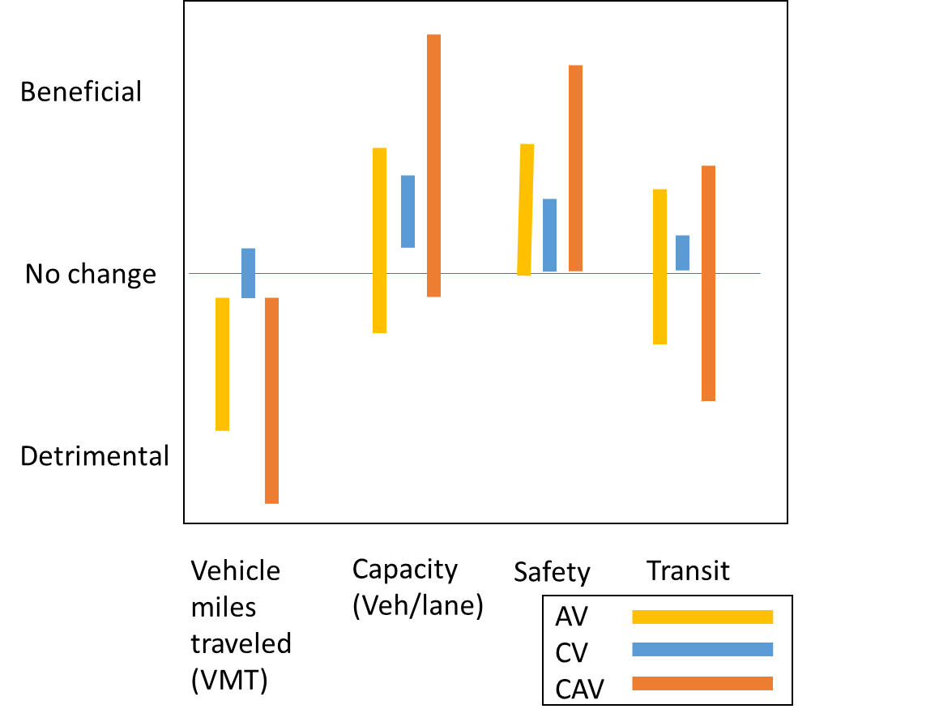
Results based on different assumption for modeling CAVs
5
Cottam, B. Transportation Planning for Connected Autonomous Vehicles: How it All Fits Together, Proceedings of the Transportation Research Board 2018 Annual Meeting, 708 – Enhancing Statewide Multimodal Planning and Modeling, Jan 7-11, 2018, Washington D.C.
The assumptions that are made can drastically effect the model performance and the expected impacts from CAVs

Slide 6
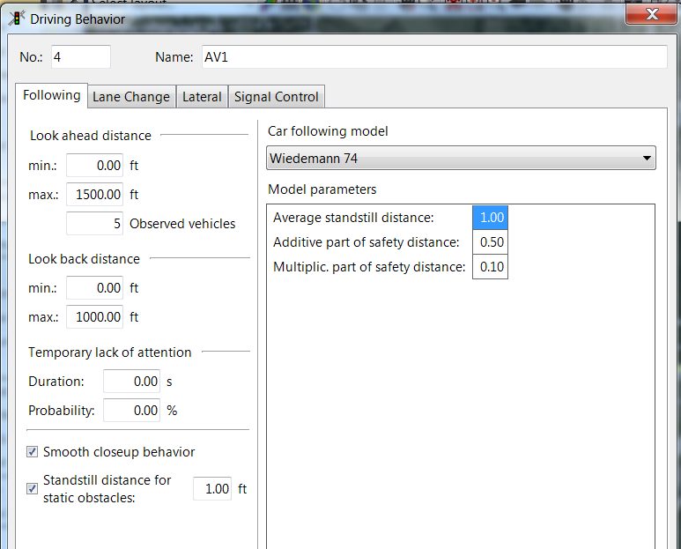
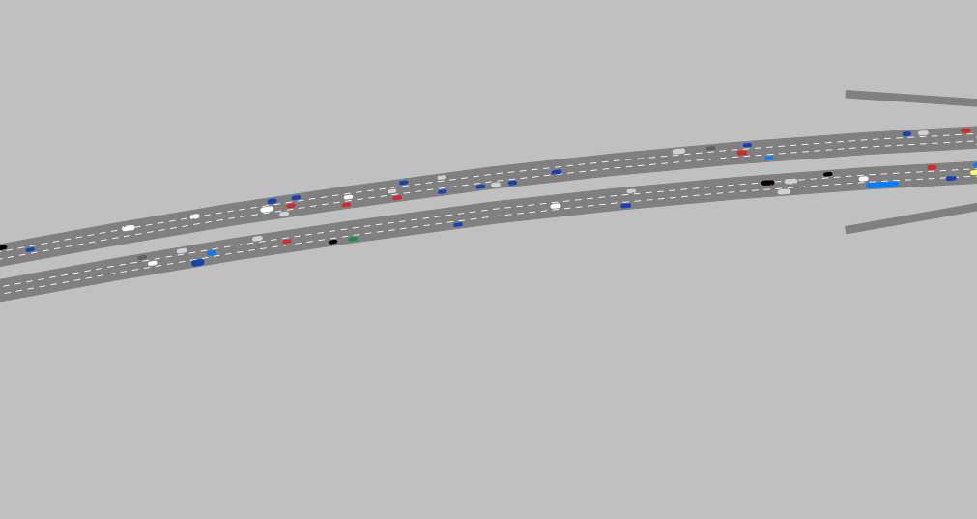
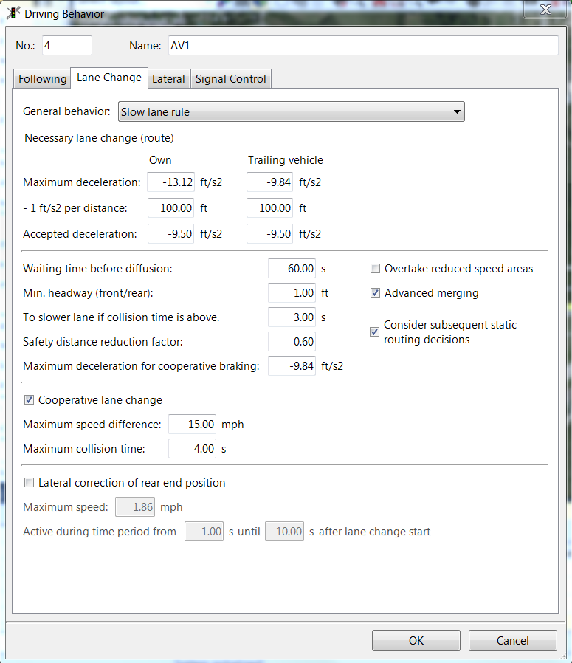
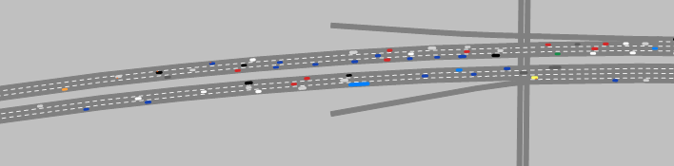
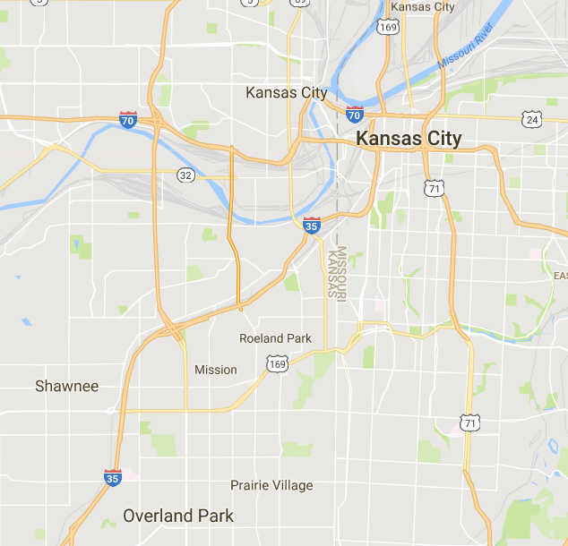
CAV network model
Autonomous and Connected Vehicle Parameter Setting
Received Permission from KDOT to use a planning study model of 7 mile corridor on
I-35
Traditional Network Parameter Setting
The autonomous and connected vehicles form closer platoons leaving much more capacity (empty space) available for additional vehicles

Slide 7
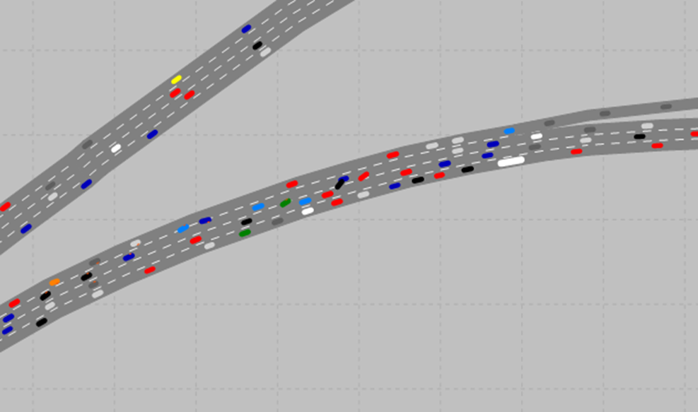
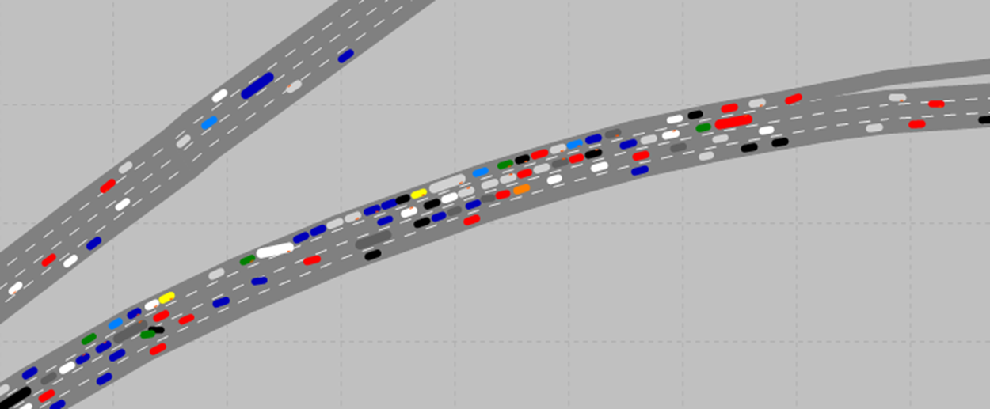
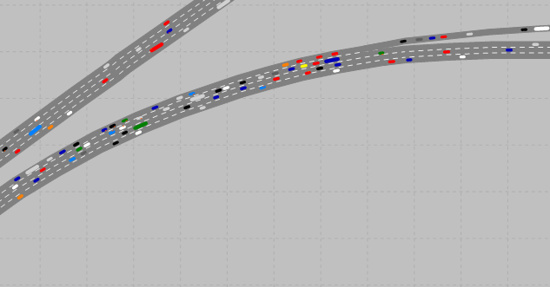
Merging Behavior - Validation
Kansas City network modeled for predicted volumes in 2040
Base scenario
71% Delay
16.7 mph
Normal driving Calibrated for Kansas City existing conditions
Original CV/AV behavior
66% Delay
19.4 mph
Reduced Following distance
Increased Cooperation
Refined CV/AV behavior
7% Delay
52.1 mph
Smaller gaps accepted for merging
Earlier decision making with more gradual speed changes
While the driving behavior worked as expected in low volume and basic freeway segment situations it did not perform appropriately with high volumes of lane changing maneuvers

Slide 8
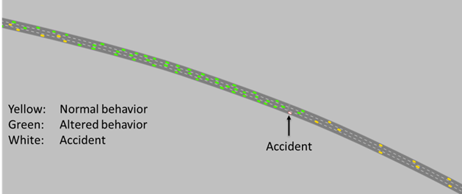
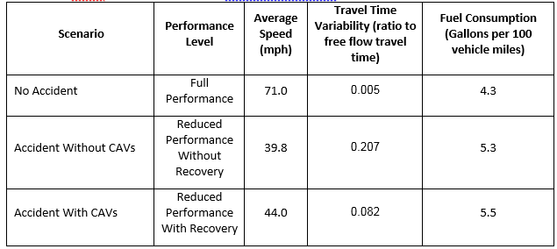
Resilience actions
Resilience actions - which actions perform better
Specking, E., Cottam, B., Cilli, M., Wade, Z., Buchanan, R., Parnell, G., Pohl, E., and Small, C., “Assessing Resilience via Multiple Measures,” Risk Analysis, Society for Risk Analysis, submitted Oct 31, 2017

Slide 9
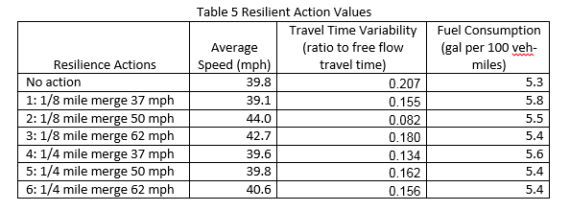
Resilient Options
Several “resilient” actions to an accident reduced the performance metrics

Slide 10
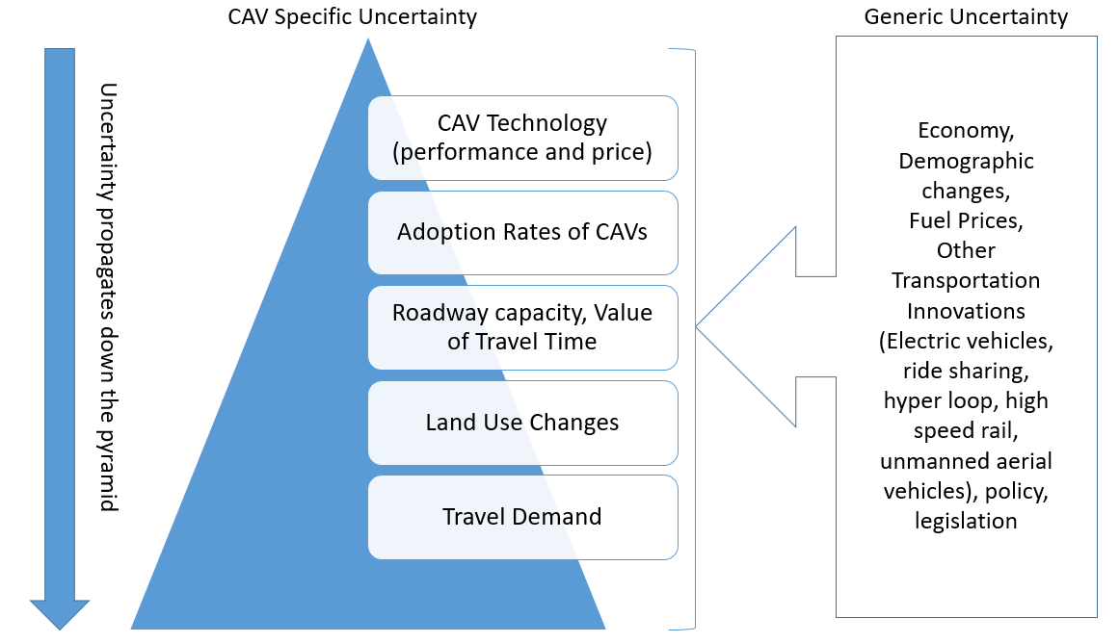
Uncertainty propagation for CAVs transportation planning
Cottam, B. Transportation Planning for Connected Autonomous Vehicles: How it All Fits Together, TRR, 2019

Slide 11

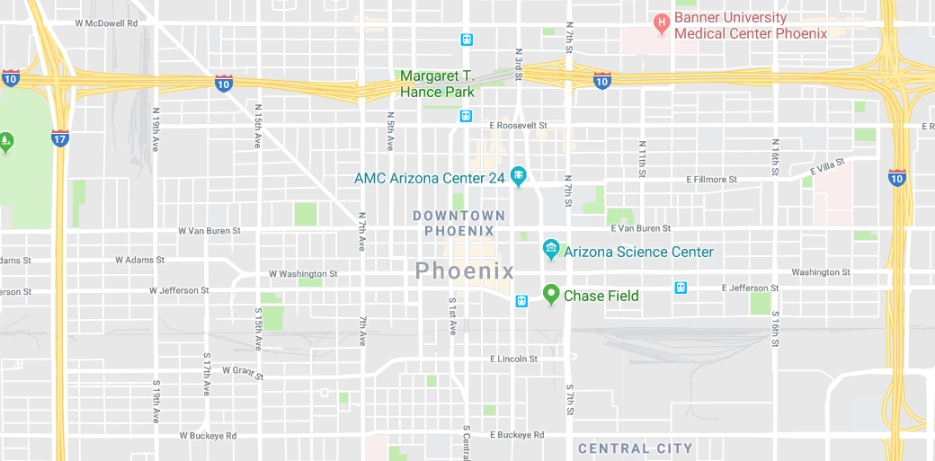
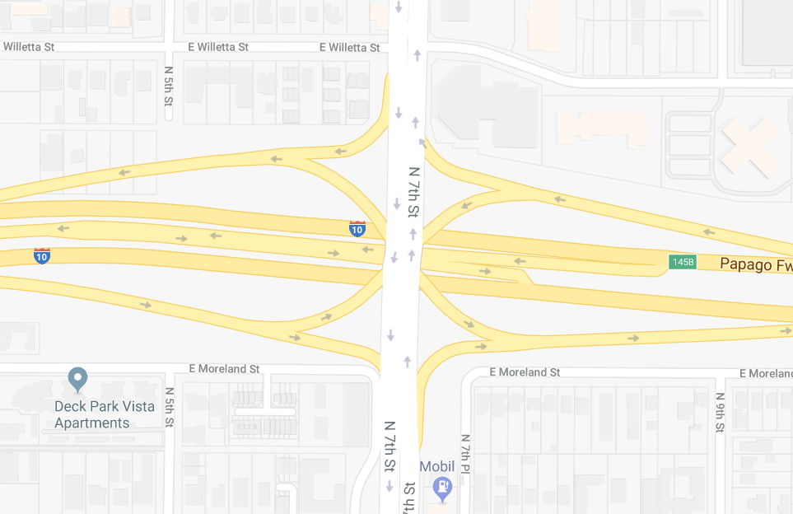
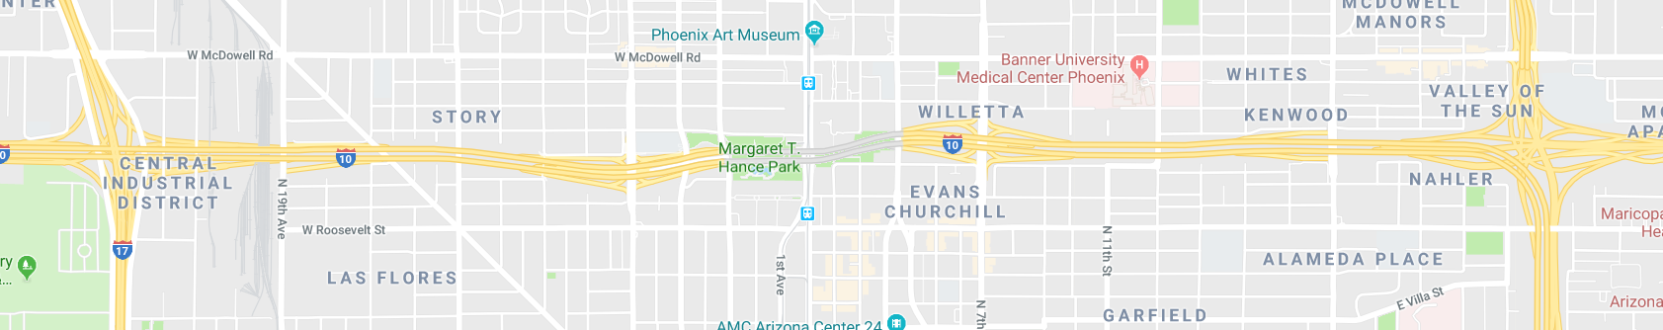
Looking at the Big Picture
Cottam, B. Transportation Planning for Connected Autonomous Vehicles: How it All Fits Together, Transportation Research Review, March 2018
Notes:
The impacts of new technology and transportation projects can expand into multiple areas, we can help understand those policies and impacts to help realize your vision for the transportation system holistically

Slide 12
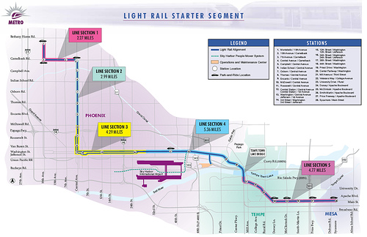
Public Transportation
Traditional ¼ mile pedestrian shed
Enhanced automated taxi pedestrian shed
Modified from https://downtownvoices.org/2008/08/06/phoenix-mayor-light-rail-ceo-answer-questions-from-businesses/

Slide 13
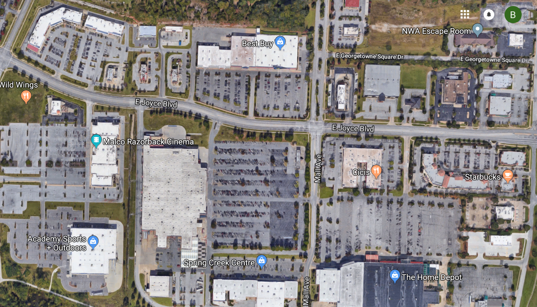
Parking
What would you do with all that space?

Slide 14
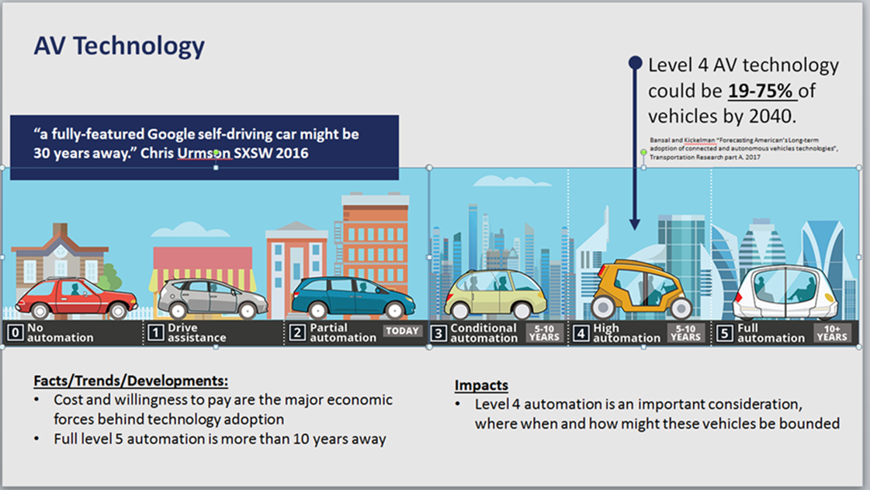
Levels of Autonomous Vehicles
Commission on the Future of Transportation in the Commonwealth. (2018). Looking at 2040 Update & Input. https://www.mass.gov/doc/massdot-looking-at-2040-update-and-input-9122018

Slide 15
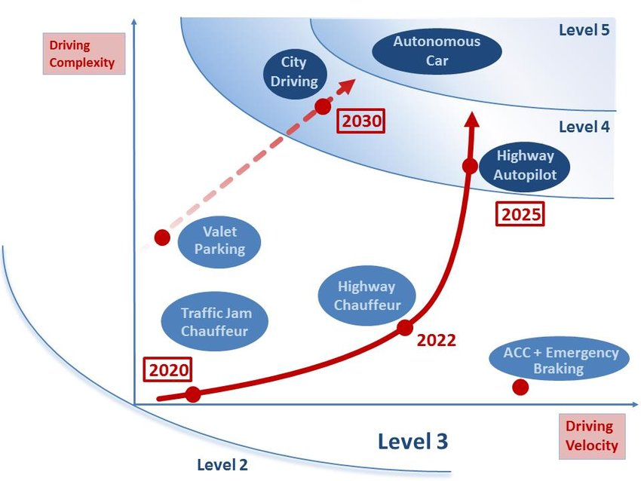
Driving Complexity
4th
3rd
2nd
1st
Modified from: Dokic, Jadranka & Müller, Beate & Meyer, Gereon. (2015). European Roadmap Smart Systems for Automated Driving.

Slide 16

Deployment Timeline
Maintenance
Planning
Operations
Legislation
Design
Improve signing and striping
Active traffic management and integrated corridor management
Increase data collection and update models
Consider alternate impact
of AVs on infrastructure
Review laws around AV testing and implementation
Consider new laws based on AVs unique performance
Consider geometry changes and lane use restrictions
Connectivity between all infrastructure assets
Consider new/additional transit options
Percent AVs in Fleet
0%
2017
5%
2025
10%
2028
15%
2030
30%
2035
50%+
Predicted year
Notes:
Purpose of Slide
Prioritize the investments that are useful now and delay decisions that are not needed, understand what the driving force, and the landscape around your decisions to determine the value that they bring
Explination of Slide
We already have many forms of Active Traffic management systems. The signal coordination, adjustable speed limits, variable message signs and general connectivity can all be enhanced with direct V2V communication and the effectiveness of messages and information is enhanced through automation when we know the that the vehicle will respond as appropriately (vs human ignoring a lower speed limit because it’s still safe just not as efficient for traffic in the long run)
Automation and connectivity are separate but synergistic tech. Connectivity is likely cheaper and easier to retrofit, along with being part of many existing business models (i.e. wifi, cell service, internet).
Because many of the activities have a very long lag time from inception though planning funding and construction it is important to consider activities well before they are actually useful or potentially even practical which is why Long range plans are useful guides. Making decisions that far in advance is difficult under uncertainty
Signing and striping better data collection reviewing legal framework and increasing connectivity all will be useful for CAVs and will be useful early into deployment at low mkt pen. And are also useful regardless which is why they are activities for starting now.
It will take much higher levels of CAVs before there is a signifigant impact to infrastructure either in bridge loading, pavement wear, and even higher before there could be a justification for design changes or giving setting aside CAV lanes since there will be too many normal users still.

Slide 17
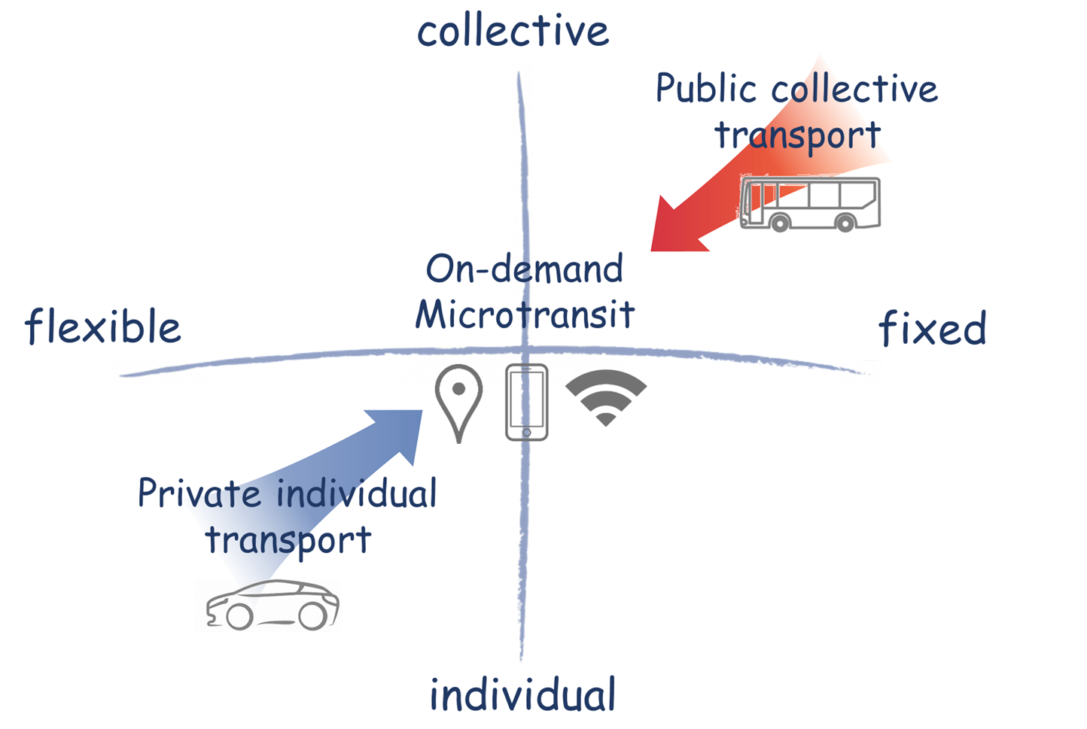
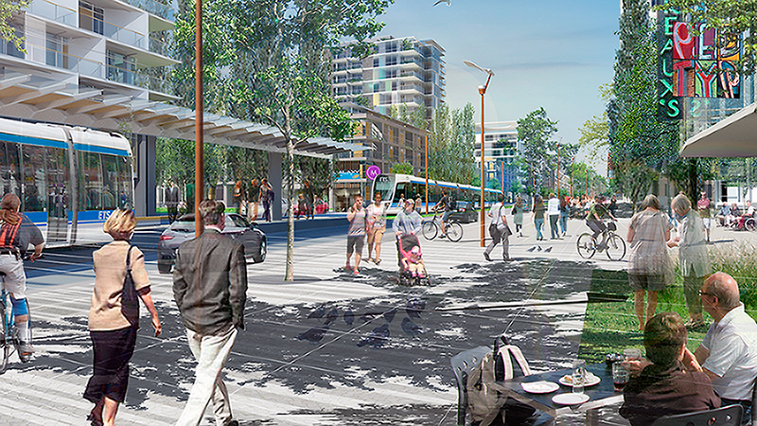
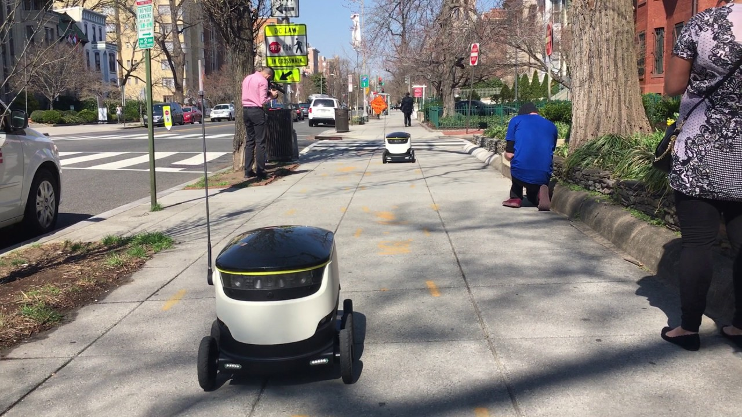
Transportation modes are less clearly defined
https://www.smart-circle.org/blog/microtransit/
https://www.edmonton.ca/city_government/city_vision_and_strategic_plan/complete-streets.aspx
https://www.youtube.com/watch?v=cWPzlmZUX-k

Slide 18
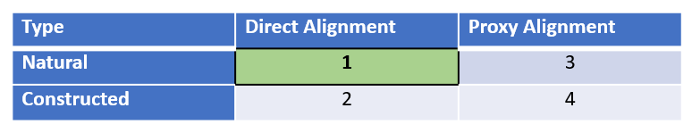
Constructing the value hierarchy
Level in the value hierarchy | Ideal properties
Each individual fundamental objective | Essential and Controllable
The set of all fundamental objectives for a decision | Complete, Nonredundant, Concise, Specific, Understandable
Sub-objectives/functions/categories | Intermediary levels to provide organization and clarity for the stakeholder to ensure completeness and aid in understanding
Value measures | Unambiguous, Comprehensive, Direct, Operational, Understandable, A priori value
Value measure order | Direct natural, Direct constructed, Proxy natural, Proxy constructed
The set of all value measures in an additive value model | Preferentially independent
Cottam, B. Incorporating Decision Analysis Best Practices into Transportation Planning Best Practices, Proceedings of the Transportation Research Board 2019 Annual Meeting

Slide 19
Transportation Value Model
Provide a transportation system that enhances the quality of life of the residents
To be equitable socioeconomically and geographically
Enhance and protect the natural environment
Provide access (to goods, services, people, opportunities, options)
Ensure safe traveling
To be affordable
Promote economic development
Protect human communities and support their development
Cottam, B. Incorporating Decision Analysis Best Practices into Transportation Planning Best Practices, Proceedings of the Transportation Research Board 2019 Annual Meeting

Slide 20
Study 1 | TS1 | TS2 | NE1 | I3 | I8 | C1
 | TS3 | TS4 | NE2 | I4 | I9 | I1
 | TS5 | I2 | NE3 | I5 | I12
 | TS6 |  | NE4 | I6
 |  |  |  | I7
 |  |  |  | I10
 |  |  |  | I11
 |  |  |  | I13
 |  |  |  | I14
 |  |  |  | I15
Study 2 | C1 | S1 | E1 | E2 | L1 | S4 | A2
 | C2 | S2 | L2 |  |  | S5
 | ED1 | S3 |  |  |  | S6
 | ED2
 | ED3
 | ED4
 | ED5
 | A1
 | A3
 | A4
 | A5
 | A6
 | L3
 | L4
Study 3 | M1 | S2 | H6 | H4 | R1 | A6 | B1
 | M2 | S3 |  | H5 | R2 | A8 | B2
 | M3 | S4 |  | H7 | R3 | A10 | B3
 | M4 | S5 |  | H9 | R4 | A13 | B4
 | M5 | S6 |  | H11 | R5 | A14 | H1
 | M6 | S7 |  |  | R6 |  | A2
 | M7 | S8 |  |  |  |  | A3
 | M8 | S9 |  |  |  |  | A4
 | H2 | S10 |  |  |  |  | A7
 | H3 | S11 |  |  |  |  | A11
 | H8 |  |  |  |  |  | A12
 | A15
 | A1
 | A5
 | A9
Study 4 | S1 | B1 |  | R2 | D2
 | M1 | B2 |  | R4
 | M2 | R3 |  | P1
 | M3 | M1
 | D1 | M2
 | D3 | M3
 | R1
 | R5
 | G1
 | G2
 | G3
 | U1

Slide 21
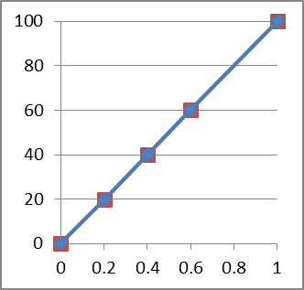
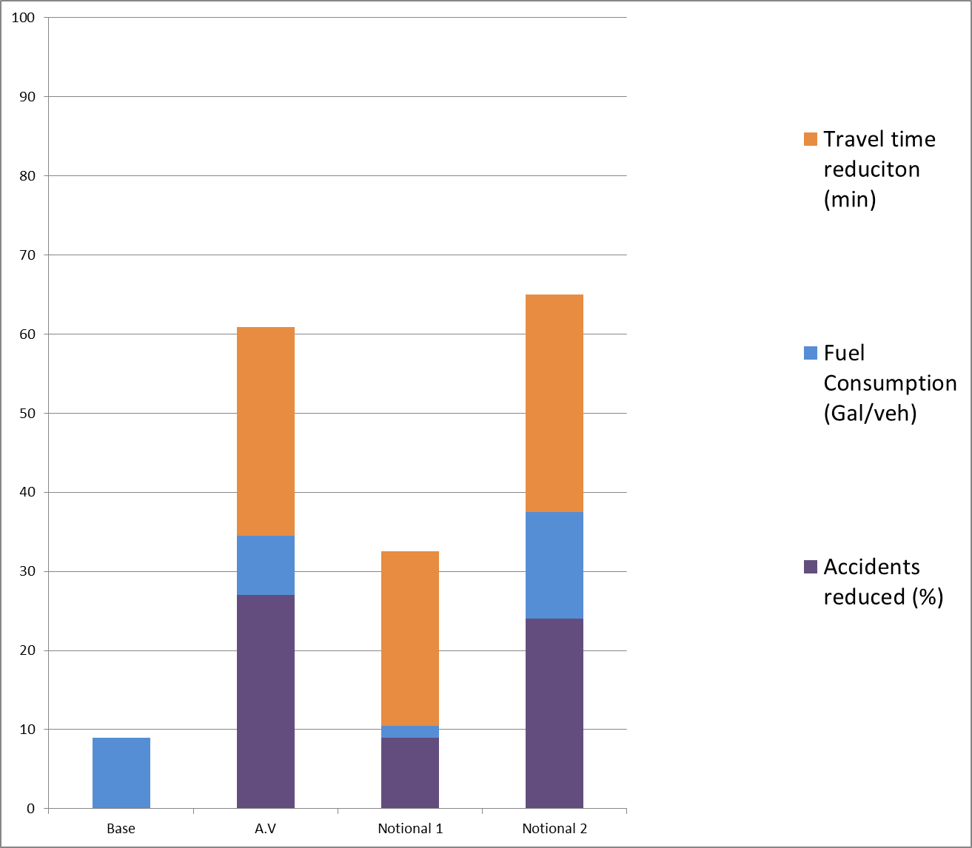
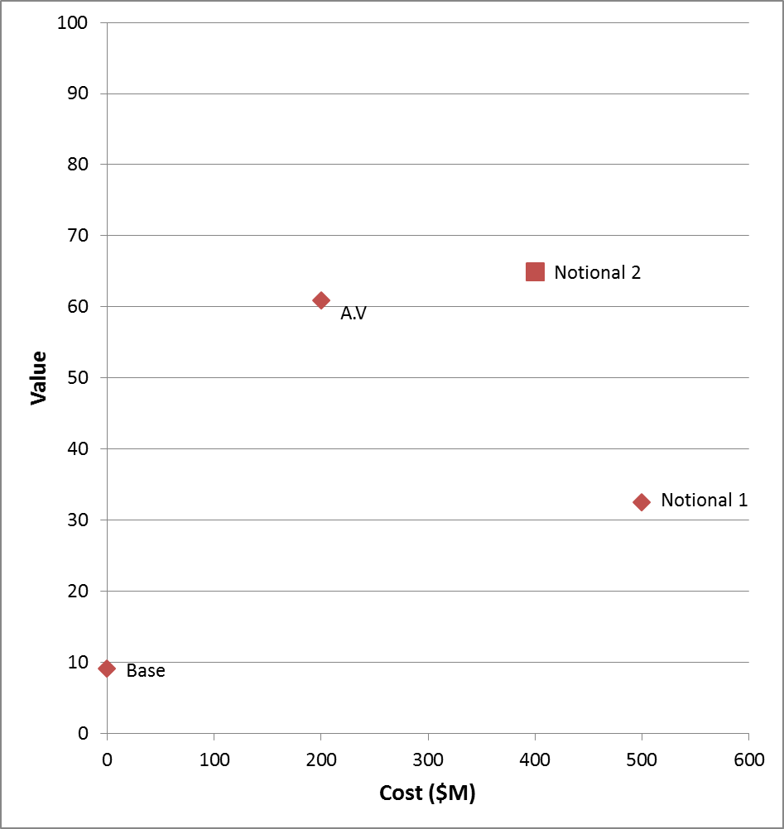
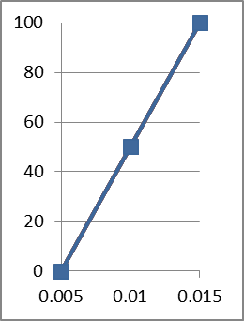
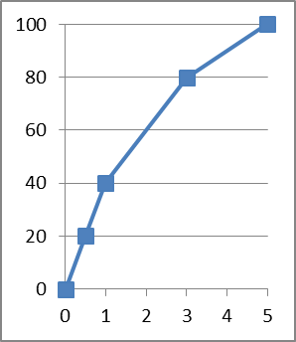
Multiple Objective Decision Analysis
Value curves
Component Value Chart for alternatives
Value vs Cost for alternatives

Slide 22
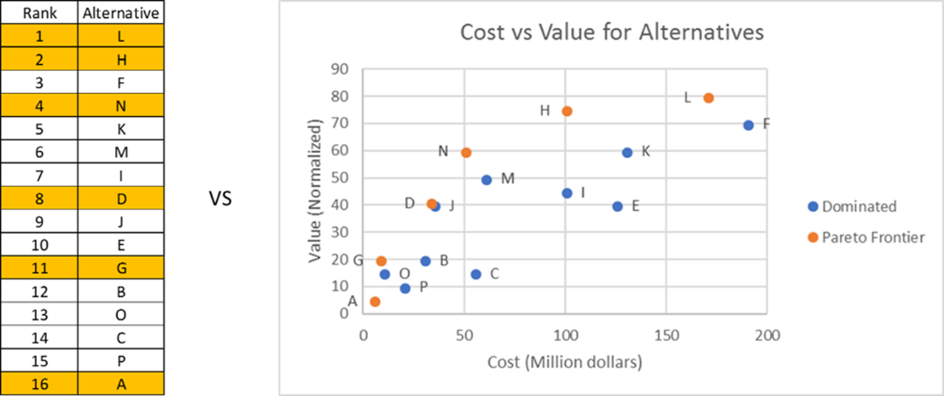
Separating Cost and Value

Slide 23
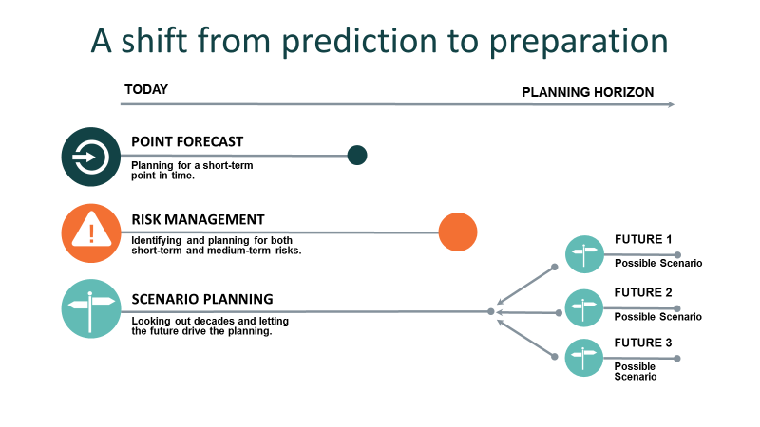
Scenario Planning

Slide 24
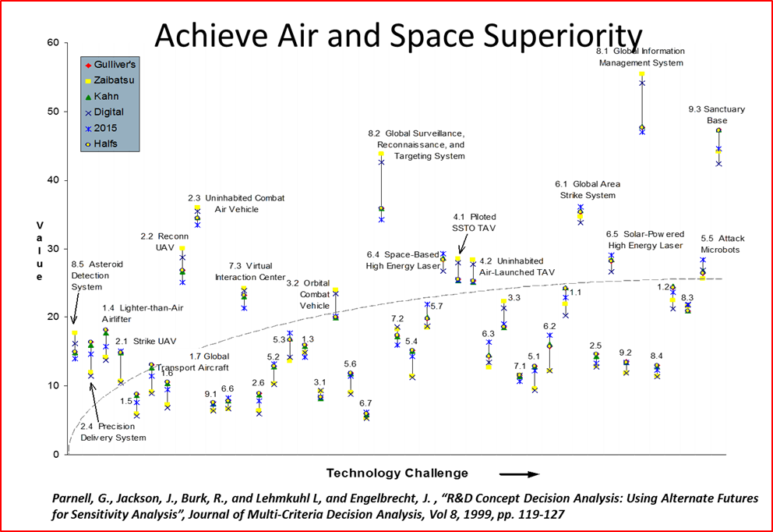
Scenario Planning Evaluation from other sectors

Slide 25
A Need for More Integrated Modeling
Public Engagement
Industry Experience on Related Experience
Traffic Modeling
Theoretical and Technical Knowledge of new topics
Decision Analysis
Strategic Modeling

Slide 26
Bobby Cottam
Traffic Engineer
Bjcottam@burnsmcd.com
479-725-5464

